Slide 1

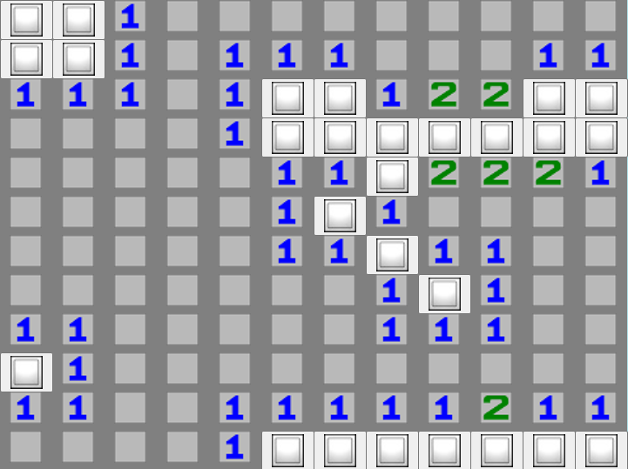
CST-247 CLC Milestone
MineSweeper Application
Cameron Deao
Vinson Martin
Joseph Cooper

Slide 2
Agenda
Minesweeper Functionality
Registration & Login
Play Minesweeper Game
Save Stats & View High scores
Save & Retrieve Gameplay
Technical Design
Game Logic
MVC 5 Web Application & Scalability requirements
User Interface
SQL Database
Secure Game Site
GitHub URL
Logging
Issues & Challenges
AJAX web-based User Interface.
Demo
CST-247 CLC Milestone-MineSweeper Application

Slide 3
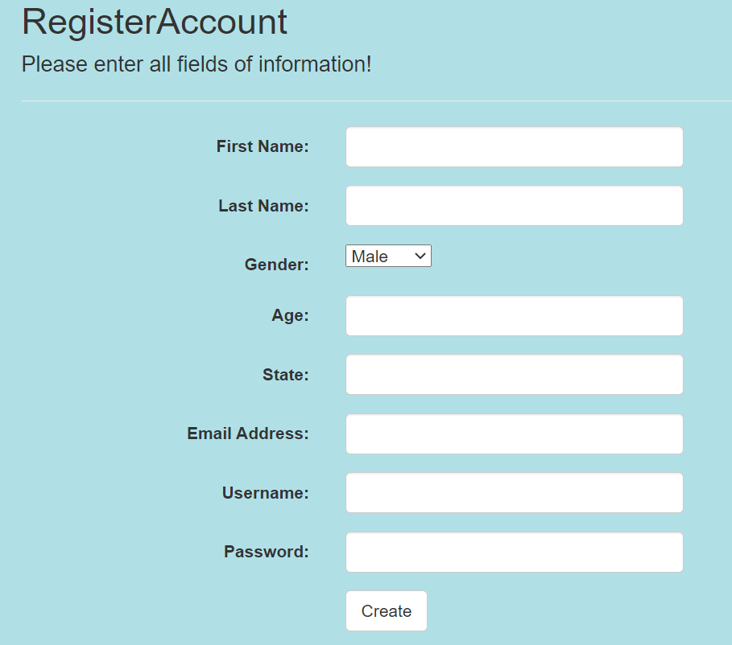
Minesweeper Functionality
Registration & Login
Users must register to able to play a Minesweeper game plus more functionality.
Registered user functionality after logging in:
  Registered users game statistics are tracked.
  Registered users has the ability to earn high scores that are displayed for the home page for all users to see.
  Registered users may save their game in the middle of a game and retrieve there save game state at a later time.
  Registered user personal information is secure.
CST-247 CLC Milestone-MineSweeper Application

Slide 4

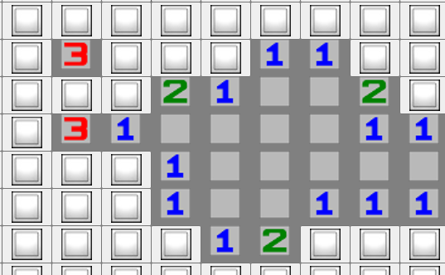
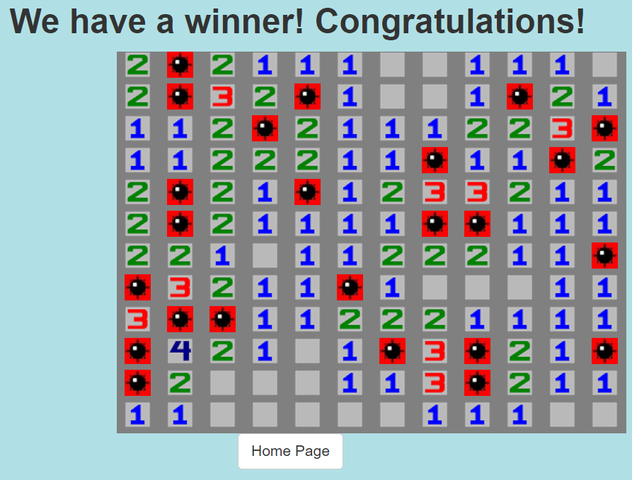
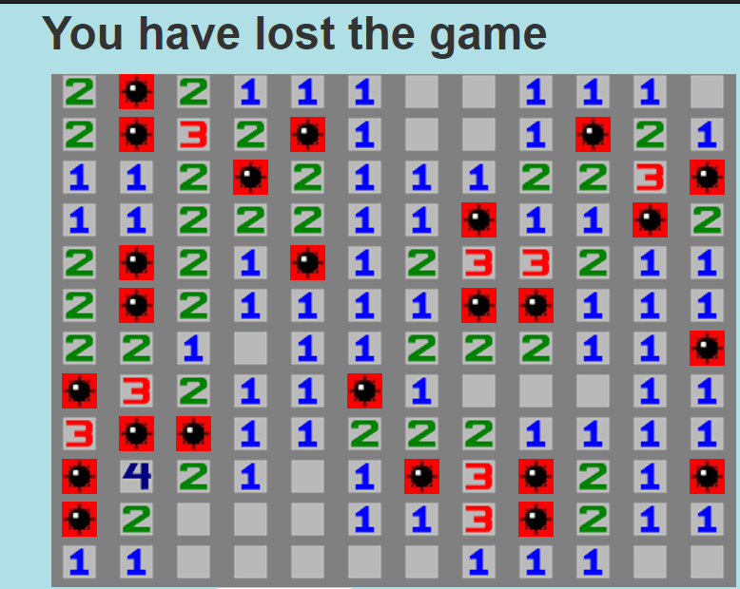
Minesweeper Functionality
Play Minesweeper Game
Users are able to experience a fully functional graphical web application version of Minesweeper.
The rules of the game:
  Users must uncover the hidden empty cells by clicking on them.
  The number on a block shows the number of mines adjacent to it.
  Users have to avoid all the mines and uncover all of the hidden boxes that does not contain mines to win the game
  If a user click on a mine, the user automatically loses.

Slide 5
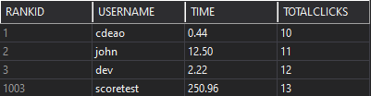
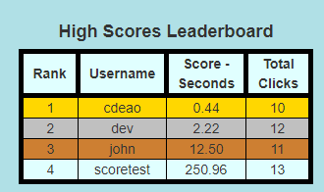
Minesweeper Functionality
Save Stats & View High scores
Stats and scores are stored in SQL Server database.
Only a single score can be stored for a user.
Scores can be upgraded based on time.
Ranks are sorted based on total seconds of time.
CST-247 CLC Milestone-MineSweeper Application

Slide 6
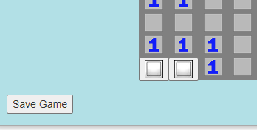
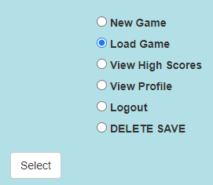
Minesweeper Functionality
Save & Retrieve Gameplay
Logged in users have the ability to save games in progress.
Once the user Logs in the next time the site is visited, the user will then be able to “Load” the saved game.
CST-247 CLC Milestone-MineSweeper Application

Slide 7
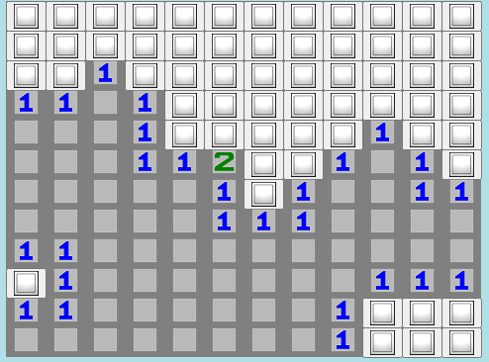
Technical Design
Game Logic
Service class is utilized for all logic.
2D Array is utilized for looping and setting neighbor values.
Selected cell is input into recursive algorithm.
  Checks north, south, east, and west for bombs.
  Recursively visited cells are set to visited state.
  Returns 2D array and converts board to List<GameSquareModel>.
CST-247 CLC Milestone-MineSweeper Application

Slide 8
Technical Design
MVC 5 Web Application & Scalability requirements
Models
Different models and service classes provides different functionalilty:
  GameBoard-Model that manipulates the entire minesweeper board
    Place Bombs
    Saves the Game State
  GameSquare-Model to manipulate a single square in the minesweeper board
    Does the square have a bomb?
    Has the square been visited?
  LeaderBoard Model to display the best scores. (Rank, UserName, Time, Total Clicks)
  Login Model that retrieves username and password for secure login functionality
  User Registration Model for users to secure register their game profile
The Minesweeper Application has the scalability to allow for easy implementation of updates
  The number of bombs, rows, and columns are all static variables for easy manipulation and possible enhancement of differing levels of difficulty
  Different models and service classes provides different functionalilty:
    GameBoard-Model to manipulated the entire gameboard
CST-247 CLC Milestone-MineSweeper Application

Slide 9
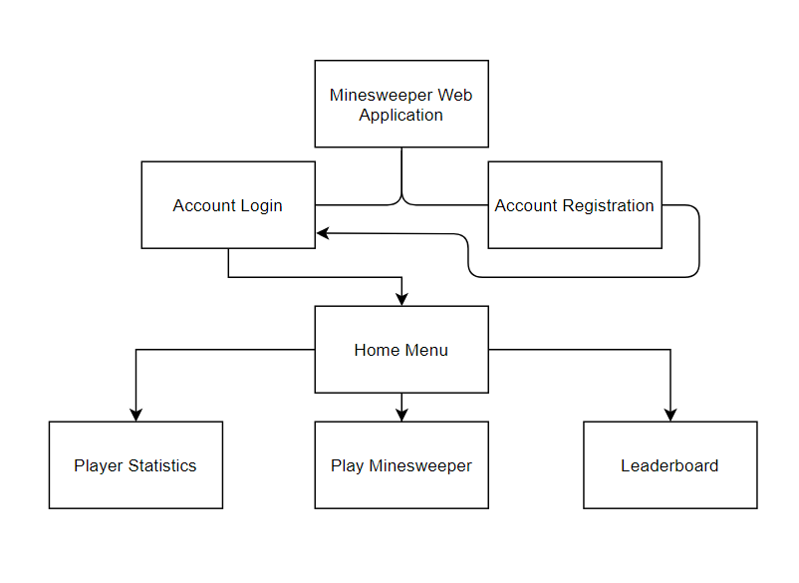
Technical Design
MVC 5 Web Application & Scalability requirements
Controllers-Different controller methods direct users to the correct views
  Home Controller
  Registration Controller
  Login Controller
  Game Controller
Views-Several views and partial views are implemented for
web interface functionality
  Header and Footer Partial layout views
  Partial view to show the updated minesweeper board
  Login and registration views
  The minesweeper board itself with a winner and loser view
Scalability requirements- The application uses static variables for the number of bombs, rows, and columns for easy scalability for later adding a difficulty setting.
CST-247 CLC Milestone-MineSweeper Application

Slide 10
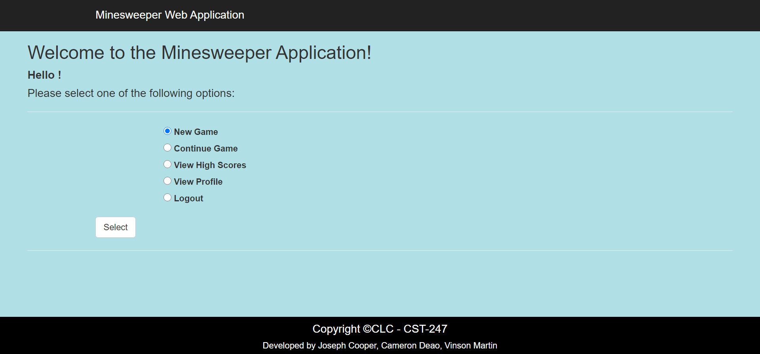
Technical Design
User Interface and Home Page View
The entire application uses common headers, footers, background options and fonts for consistency and contrast. “Minesweeper Web Application” in the header routes you back to the Login interface.
After logging in, the user can select their option with the radio button, then press “Select” to proceed.
New Game and Continue Game take the user to the Game Board View and starts a new game and gets the saved game respectively.
View High Scores and View Profiles allows the user to view other user’s high scores and view their profile respectively.
Logout also routes the user back to the Login interface.
CST-247 CLC Milestone-MineSweeper Application

Slide 11
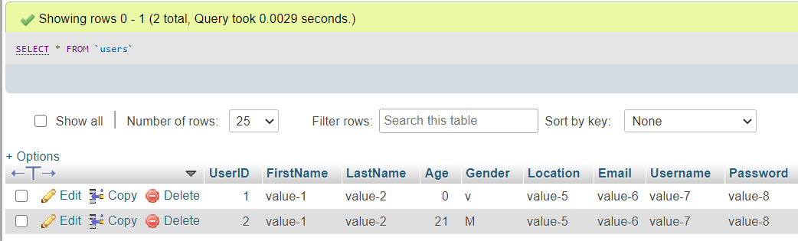
Technical Design
SQL Models for User Login/Registration
The initial SQL snippets and integration focused on the Users table
The table columns include UserID, FirstName, LastName, Age, Gender, Location, Email, Username, and Password.
The UserID was used as the primary key to link user information to their accounts and other tables in the entity.
Insert statement for Registration page: INSERT INTO `users`(`FirstName`, `LastName`, `Age`, `Gender`, `Location`, `Email`, `Username`, `Password`) VALUES ("value-1","value-2",21,"M","value-5","value-6","value-7","value-8");
Select statement for Login page: SELECT * FROM `users` WHERE Username = "value-7" AND Password = "value-8";
CST-247 CLC Milestone-MineSweeper Application

Slide 12
Technical Design
SQL Entity Table for Users
Users
UserID (Primary Key; Auto Increment) | Int(11)
FirstName | Varchar(25)
LastName | Varchar(25)
Age | Int(11)
Gender | Varchar(1)
Location | Varchar(25)
Email | Varchar(50)
Username | Varchar(25)
Password | Varchar(25)
CST-247 CLC Milestone-MineSweeper Application

Slide 13

Technical Design
User passwords are encrypted for storage with 256 bit symmetric key algorithm.
Encryption key is stored in Web.config for security measures.
Model password is encrypted during registration.
Model password is decrypted during login.
No plaintext passwords are stored or exist within the application.
Utilizes the System.Security.Cryptography .NET Namespace
CST-247 CLC Milestone-MineSweeper Application

Slide 14
Technical Design
Secure Game Site
Encryption Call
user.Password = Encrypt(System.Web.Configuration.WebConfigurationManager
.AppSettings["Key"], user.Password);
Encryption Method
public static string Encrypt(string key, string incStr) {
byte[] iv = new byte[16];
byte[] array;
using(Aes aes = Aes.Create())
{ aes.Key = Encoding.UTF8.GetBytes(key);
aes.IV = iv;
ICryptoTransform encryptor = aes.CreateEncryptor(aes.Key, aes.IV);
using(MemoryStream ms = new MemoryStream())
{ using(CryptoStream cs = new CryptoStream((Stream)ms, encryptor, CryptoStreamMode.Write))
{using(StreamWriter streamWriter = new StreamWriter((Stream)cs))
{streamWriter.Write(incStr);}
array = ms.ToArray();}}}
CST-247 CLC Milestone-MineSweeper Application

Slide 15
Technical Design
Secure Game Site
Decryption Call
if (Decrypt(System.Web.Configuration.WebConfigurationManager.AppSettings["Key"], reader.GetString(8)) != user.Password) { return false; }
Decryption Method
public static string Decrypt(string key, string incStr) {
byte[] iv = new byte[16];
byte[] buffer = Convert.FromBase64String(incStr);
using(Aes aes = Aes.Create()) {
aes.Key = Encoding.UTF8.GetBytes(key);
aes.IV = iv;
ICryptoTransform decryptor = aes.CreateDecryptor(aes.Key, aes.IV);
using (MemoryStream ms = new MemoryStream(buffer)) {
using(CryptoStream cs = new CryptoStream((Stream)ms, decryptor, CryptoStreamMode.Read)) {
using(StreamReader sr = new StreamReader((Stream)cs))
{ return sr.ReadToEnd(); }}}}}
CST-247 CLC Milestone-MineSweeper Application

Slide 16
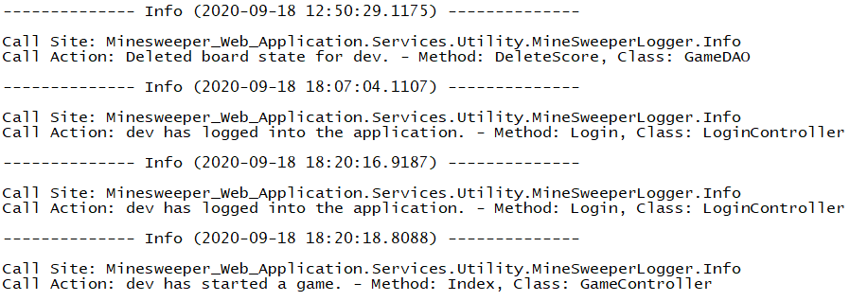
Technical Design
GitHub URL
https://github.com/cmdeao/CLC---CST-247
Logging
NLog was utilized for structured and traditional logging.
Singleton was created for immediate access anywhere.
SQL Exceptions were logged with ‘Error’ level.
StackFrame was utilized track class and method origin of logging.
Log is output to file showcasing date, time, call site, and call action
CST-247 CLC Milestone-MineSweeper Application

Slide 17
Issues and Challenges
AJAX Web-Based Interface
AJAX forms passed data to controllers properly.
AJAX Partial Views never updated based on model data.
  No resolution was found.
Repository Issues
Repository was established incorrectly.
  .gitignore file was missing.
Numerous merge conflicts arose towards the end of production.
  Resolved conflicts within Visual Studio manually.
CST-247 CLC Milestone-MineSweeper Application

Slide 18
CST-247 CLC Milestone
MineSweeper Application
Cameron Deao
Vinson Martin
Joseph Cooper
Thank you for joining our presentation.
Enjoy the Demo!!!!
https://www.youtube.com/watch?v=Xo3WCpUipdo

